Slide 1
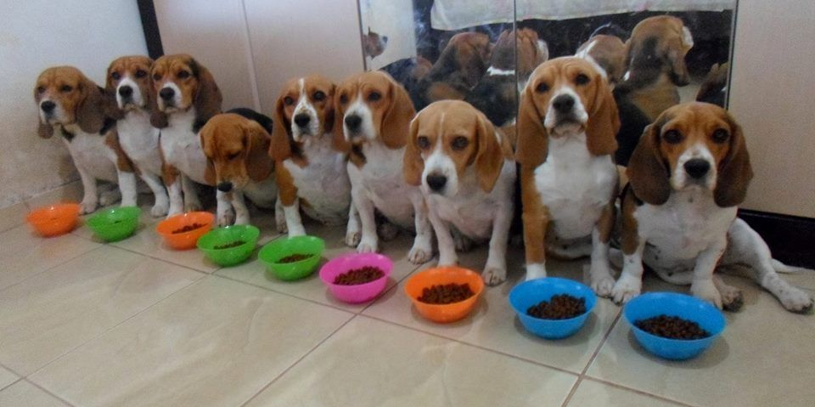
Multi-threading

Slide 2
C# threads
Concurrency
Creating and starting threads
Suspending, resuming and stopping threads
Background and foreground threads
Thread priorities

Slide 3
Concurrency – What?
Things happening at the same time.
(or switching tasks so fast, that we get the illusion
of things happening at the same time)
Notes:
Things happening at the same time (or switching tasks so fast, that we get the illusion of things happening at the same time).
If we have more than one CPU core, we can also achieve parallelism.

Slide 4
Concurrency – Why?
Notes:
Until now, everything happened nice and sequentially in our programs. Why would we want to change that?
We are going down the rabbit hole...

Slide 5
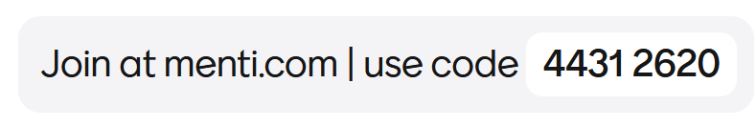


Slide 6
Concurrency in C# - How?
Threads - today and the coming week(s)
Tasks – Covered in Software Design next semester

Slide 7
Creating and starting threads
public class LotsOfWork
{
public void DoLotsOfWork()
{
for (int i = 0; i < 1000; i++)
{
// TODO: add a lot of work here..
Console.WriteLine("iteration: {0}", i);
}
}
}
Notes:
I have a method that does a lot of work.

Slide 8
Creating and starting threads
class Program
{
static void Main(string[] args)
{
LotsOfWork work = new LotsOfWork();
Thread myThread = new Thread(work.DoLotsOfWork);
myThread.Start();
System.Console.ReadKey();
}
}
Notes:
So lets run that method on its own thread.

Slide 9
Creating and starting threads
class Program
{
static void Main(string[] args)
{
LotsOfWork work = new LotsOfWork();
Thread myThread = new Thread(work.DoLotsOfWork);
myThread.Start();
System.Console.ReadKey();
}
}
public class LotsOfWork
{
public void DoLotsOfWork()
{
for (int i = 0; i < 1000; i++)
{
// TODO: add a lot of work here..
Console.WriteLine("iteration: {0}", i);
}
}
}
Notes:
We tell the thread which method to run, by giving it the method in the constructor.
The method will be run, when the thread is started.

Slide 10
Passing parameters - Properties
class Program
{
static void Main(string[] args)
{
LotsOfWork work = new LotsOfWork();
Thread myThread = new Thread(work.DoLotsOfWork);
work.NumberOfIterations = 500;
myThread.Start();
System.Console.ReadKey();
}
}
public class LotsOfWork
{
public int NumberOfIterations { get; set; } = 0;
public void DoLotsOfWork()
{
for (int i = 0; i < NumberOfIterations; i++)
{
// TODO: add a lot of work here..
Console.WriteLine("iteration: {0}", i);
}
}
}
Notes:
Parameters to the LotsOfWork instance can be given as properties.

Slide 11
Passing parameters – To the Start() method
class Program
{
static void Main(string[] args)
{
LotsOfWork work = new LotsOfWork();
Thread myThread = new Thread(work.DoLotsOfWork);
myThread.Start(500);
System.Console.ReadKey();
}
}
public class LotsOfWork
{
public void DoLotsOfWork(object parameter)
{
int numberOfIterations = (int) parameter;
for (int i = 0; i < numberOfIterations; i++)
{
// TODO: add a lot of work here..
Console.WriteLine("iteration: {0}", i);
}
}
}
https://learn.microsoft.com/en-us/dotnet/api/system.threading.thread.start?view=net-6.0#system-threading-thread-start(system-object)
Notes:
Or we can pass parameters to the thread, when we start the thread.
NOTE: We could also use lambda expressions https://stackoverflow.com/questions/1195896/threadstart-with-parameters

Slide 12

Your turn
Solve exercises 1 and 2

Slide 13
Pausing a thread
public class LotsOfWork
{
public void DoLotsOfWork(object parameter)
{
int numberOfIterations = (int) parameter;
for (int i = 0; i < numberOfIterations; i++)
{
// TODO: add a lot of work here..
Console.WriteLine("iteration: {0}", i);
Thread.Sleep(50); // 50 milliseconds
}
}
}
The thread will sleep for
at least 50 milliseconds.

Slide 14
Yield
public class LotsOfWork
{
public void DoLotsOfWork(object parameter)
{
int numberOfIterations = (int) parameter;
for (int i = 0; i < numberOfIterations; i++)
{
// TODO: add a lot of work here..
Console.WriteLine("iteration: {0}", i);
Thread.Sleep(0); // Yield
}
}
}
Sleep(0) means that the thread yields.
If another thread is ready to run, it will run.
If no other thread is ready to run, the thread that yielded will continue.

Slide 15
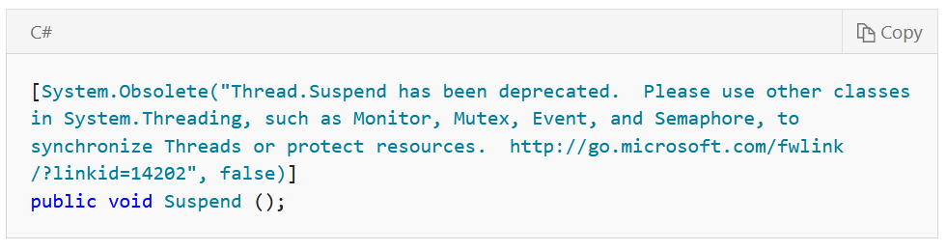

Don’t use Thread.Suspend and Thread.Resume
https://learn.microsoft.com/en-us/dotnet/api/system.threading.thread.suspend?view=net-6.0#system-threading-thread-suspend
https://learn.microsoft.com/en-us/dotnet/api/system.threading.thread.resume?view=net-6.0#system-threading-thread-resume
Notes:
We will talk about thread synchronization next week.

Slide 16
When does the program exit?
class Program
{
static void Main(string[] args)
{
LotsOfWork work = new LotsOfWork();
Thread myThread = new Thread(work.DoLotsOfWork);
myThread.Start();
System.Console.WriteLine(”Goodbye from main");
System.Console.ReadKey();
}
}
public class LotsOfWork
{
public void DoLotsOfWork()
{
for (int i = 0; i < 1000; i++)
{
// TODO: add a lot of work here..
Console.WriteLine("iteration: {0}", i);
}
}
}
Notes:
When do we see the ”Goodbye from main” line in the console?
When does the program exit?

Slide 17
Waiting for other threads to complete (join)
class Program
{
static void Main(string[] args)
{
LotsOfWork work = new LotsOfWork();
Thread myThread = new Thread(work.DoLotsOfWork);
myThread.Start(50);
myThread.Join();
System.Console.WriteLine("Hello from main");
System.Console.ReadKey();
}
}
The Join() method blocks the caller until the thread on which join was called completes.

Slide 18
Waiting for other threads to complete (join)
class Program
{
static void Main(string[] args)
{
LotsOfWork work = new LotsOfWork();
Thread myThread = new Thread(work.DoLotsOfWork);
myThread.Start(50);
myThread.Join(1000); // continue if not joined after 1000 ms
System.Console.WriteLine("Hello from main");
System.Console.ReadKey();
}
}
But you can specify a timeout.

Slide 19
Your turn
Solve exercises 3, 4, and 5

Slide 20
Background and foreground threads
class Program
{
static void Main(string[] args)
{
LotsOfWork work = new LotsOfWork();
Thread myThread = new Thread(work.DoLotsOfWork);
myThread.IsBackground = true;
myThread.Start(50);
System.Console.ReadKey();
}
}
The program will now terminate instantly, when a key is pressed, because myThread is a background thread.

Slide 21
Stopping a thread - gracefully
class Program
{
static void Main(string[] args)
{
LotsOfWork work = new LotsOfWork();
Thread myThread = new Thread(work.DoLotsOfWork);
myThread.Start();
System.Console.ReadKey();
work.ShallStop = true;
}
}
public class LotsOfWork
{
public bool ShallStop { get; set; } = false;
public void DoLotsOfWork()
{
int iteration = 0;
while (!ShallStop)
{
Console.WriteLine("iteration: {0}", iteration);
Thread.Sleep(50); // 50 milliseconds
iteration++;
}
Console.WriteLine("Thread is done!");
}
}
Notes:
If we want to stop a thread gracefully, we shall add a way to tell it to the thread.
For instance through a property.
Another way could be to send it a message, if the thread consumes messages.
Or give the thread a ”CancellationToken” object as the parameter to the myThread.Start() method.

Slide 22
Aborting a thread (not so graceful)
class Program
{
static void Main(string[] args)
{
LotsOfWork work = new LotsOfWork();
Thread myThread = new Thread(work.DoLotsOfWork);
myThread.Start();
System.Console.ReadKey();
myThread.Abort();
}
}
public class LotsOfWork
{
public bool ShallStop { get; set; } = false;
public void DoLotsOfWork()
{
int iteration = 0;
while (!ShallStop)
{
Console.WriteLine("iteration: {0}", iteration);
Thread.Sleep(50); // 50 milliseconds
iteration++;
}
Console.WriteLine("Thread is done!");
}
}
Obsolete: From .NET 5.0 and onwards, this will add a compile time warning. So close threads in gracefully

Slide 23
Aborting a thread (not so graceful)
class Program
{
static void Main(string[] args)
{
LotsOfWork work = new LotsOfWork();
Thread myThread = new Thread(work.DoLotsOfWork);
myThread.Start();
System.Console.ReadKey();
myThread.Abort();
}
}
Avoid Abort() if you can.
Abort() throws an exception on the thread.
You don’t know what the thread was doing, when it was aborted.
The exception can be caught by the thread (and the thread keeps running...).

Slide 24

Thread priorities - Danger, beware!
The .NET scheduler uses thread priorities when deciding which thread to run.
You almost never want to mess with this. So don’t!
Notes:
You can run into strange behavior and thread starvation.
But if you write software with realtime requirements, it is essential to consider priorities.

Slide 25
Your turn
Solve exercises 6, 7, and 8

Slide 27
References and image sources
Images:
Down the rabbit hole: https://i.pinimg.com/originals/3b/a4/1c/3ba41c16b44edd7d9c5c9faeec965fad.gif
Computer keyboard: http://stockmedia.cc/computing_technology/slides/DSD_8790.jpg
Nuclear explosion: http://www.greenpeace.org/international/en/multimedia/photos/mushroom-cloud/

